Slide 1
ONAP for xNF Based 5G Service Orchestration
Łukasz Rajewski, Michał Chabiera (Orange)
Abderaouf Khichane, Ilhem Fajjari (Orange)
Seshu Kumar (Huawei)
13.01.2022

Slide 2
ONAP for xNF Orchestration

Slide 3


ONAP for xNF Orchestration
Net. Slicing
Closed Loop
ETSI
Rel. 6
Rel. 1
Rel. 3
Design
Runtime
Rel. 1
Rel. 1
PNF
VNF
CNF
Rel. 3
Rel. 1
Rel. 4
Amsterdam
11.2017
Beijing
6.2018
Casablanca
12.2018
El Alto
10.2019
Frankfurt
6.2020
Guilin
12.2020
Honolulu
5.2021
Istanbul
11.2021
Dublin
7.2019

Slide 4
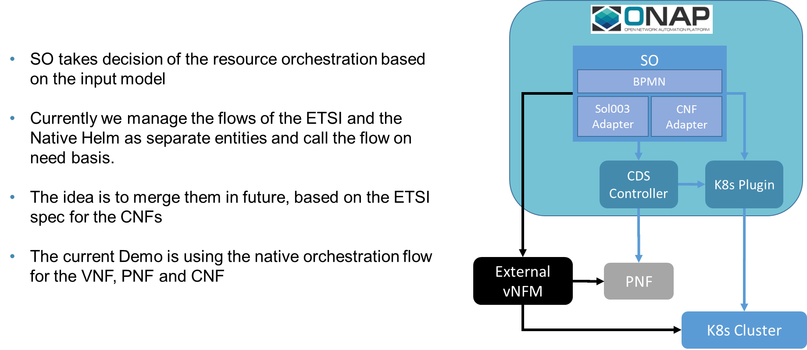
ONAP Orchestration Scenarios: Native vs ETSI

Slide 5
Towards5GS

Slide 6

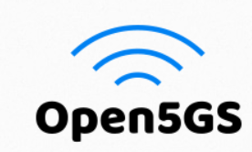




Rationale
Several open-source projects are dealing with the implementation of
5G core network
None of them is providing tools to perform on Kubernetes platform
Towards5GS provides Helm charts for deploying and testing
a containerized 5G service on top of Kubernetes
Notes:
Déplacer la 2ème brique au slide 4 et commencer par parler de l’objectif

Slide 7




5G-related software
Open source 5G core network based on 3GPP R15
The ultimate goal of this project is to implement the 5G core network (5GC) defined in 3GPP Release 15 (R15) and beyond
Supported versions are v3.0.4 and v3.0.5
Open source 5G User Equipment (UE) and gNodeB (gNB) implementation
The project can be used for testing 5G Core Network and studying E2E 5G System
The latest supported version is v3.2.4
AUSF
NSSF
PCF
NRF
UDM
UDR
gNB
AMF
SMF
UE
UPF
N3IWF
Notes:
Avec une version basique de kubernetes avec les composants en bleu qui existe dans n’importe quel cluster kubernetes plus les addons en orange de telle sorte que notre cluster réponde aux besoins de notre fonction réseau
How it works ?
This project has been designed to be consumded in three ways :
Baremetal deployment
Vagrant
Containerized
Provisioning the Kubernetes cluster is done by excuting Ansible playbooks.
Expliquer OVN,

Slide 8
5G-related software
Open source 5G core network based on 3GPP R15
The ultimate goal of this project is to implement the 5G core network (5GC) defined in 3GPP Release 15 (R15) and beyond
Supported versions are v3.0.4 and v3.0.5
Open source 5G User Equipment (UE) and gNodeB (gNB) implementation
The project can be used for testing 5G Core Network and studying E2E 5G System
The latest supported version is v3.2.4
Links:
Free5GC: https://github.com/free5gc/free5gc
UERANSIM: https://github.com/aligungr/UERANSIM
Notes:
Avec une version basique de kubernetes avec les composants en bleu qui existe dans n’importe quel cluster kubernetes plus les addons en orange de telle sorte que notre cluster réponde aux besoins de notre fonction réseau
How it works ?
This project has been designed to be consumded in three ways :
Baremetal deployment
Vagrant
Containerized
Provisioning the Kubernetes cluster is done by excuting Ansible playbooks.
Expliquer OVN,

Slide 9
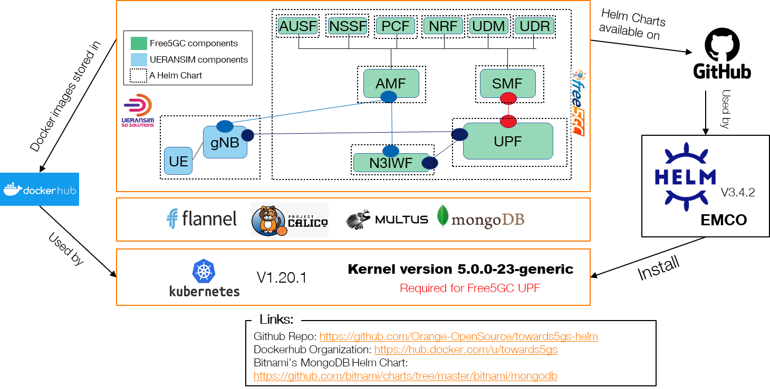
Towards5GS platform
Notes:
Avec une version basique de kubernetes avec les composants en bleu qui existe dans n’importe quel cluster kubernetes plus les addons en orange de telle sorte que notre cluster réponde aux besoins de notre fonction réseau
How it works ?
This project has been designed to be consumded in three ways :
Baremetal deployment
Vagrant
Containerized
Provisioning the Kubernetes cluster is done by excuting Ansible playbooks.
Expliquer OVN,

Slide 10
Orchestration of Free5GC using ONAP

Slide 11











ONAP for xNF Based 5G Service Orchestration
PNF
CNF
CNF
CNF
VNF
VNF
xNF Orchestration
ADMIN
CNF
CNF
CNF
INTERNET
5G RAN PNF/CNF
5G CORE CNF
UE
PING google.com

Slide 12
ONAP for xNF Based 5G Service Orchestration
ONBOARDING
CNF DEPLOYMENT
PNF REGISTRATION
CNF/PNF STATUSCHECK
CNF <-> PNF CONFIG SYNCH
SUBSCRIPTION
CONNECTIVITY TEST
NRF SCALING
xNF Orchestration
ADMIN
INTERNET
5G RAN PNF/CNF
5G CORE CNF
UE
PING google.com

Slide 13
Joint CBA for RAN and Core Part NF
Resource
Assignment
1
Config deploy
UE reconfiguration
Config Setup
Config Setup
2
5
PNF Registration
Config Upload
RAN Part
6
3
UE Subscribe
Status Verification
Resource Assignment
Config Apply
7
CBA
Config deploy
NRF Scaling
8
Profile Upload
Config Setup
Config Setup
3
Config Upload
CORE Part
Status Verification
4
Config Apply
PNF Reconfiguration
Status Verification

Slide 14
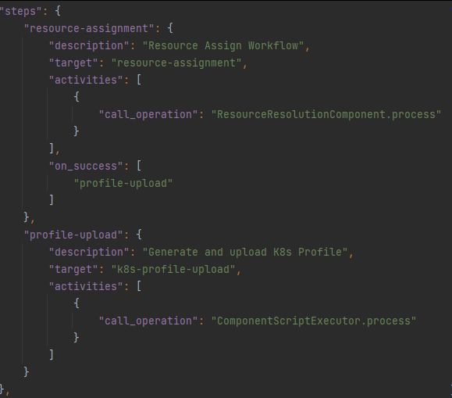
Resource Assignment (CNF/PNF)
1
Resource Assignment:
First of the ways to enrich Helm package
Resolves overrides for Helm instantiation
It is supplemented by profiling
We use it to gather inputs and prepare for profiling
Result is stored in MDSAL and can be easily used during Day2 operations
ResourceResolutionComponent used

Slide 15
Resource Assignment (CNF/PNF)
1
Profiling mechanism allows to also parametrize complex overrides values
values.yaml file is taken from the profile
original helm chart is not modified
There are two types of profiles
static – predefined in CBA
dynamic – generated and templated during instantiation
CBA may have many profils with predefined overrides.
K8sProfileUploadComponent is used

Slide 16
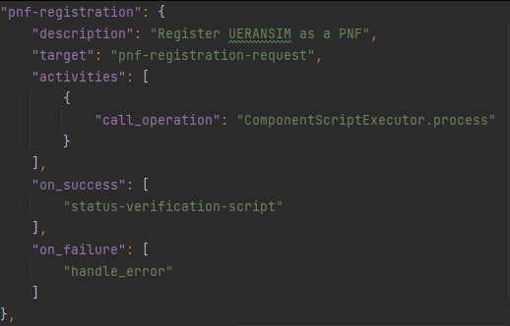
Config Deploy: PNF Registration
2
Service model is composed of PNF and CNF
PNF is simulated by UERANSIM solution
In order to register PNF in ONAP PNF Plug and Play procedure is used
This step sends PNF registration event to PRH component of DCAE
CNF Core instantiation waits until PNF Registration finishes

Slide 17
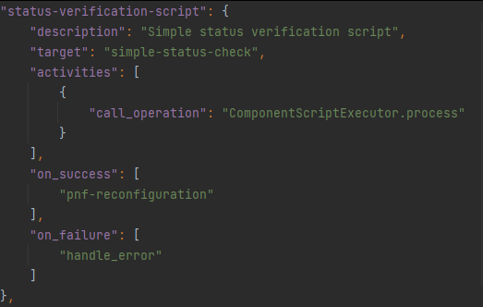
Config Deploy: Status Verification
3
Procedure verifies if CNF is up and running
All k8s resources created must have „Running” state to continue
Script calls k8sPlugin Status API
Instance status verification checks value of ready flag:
False means deployment in progress
True means deployment is finished
ComponentScriptExecutor operation used

Slide 18
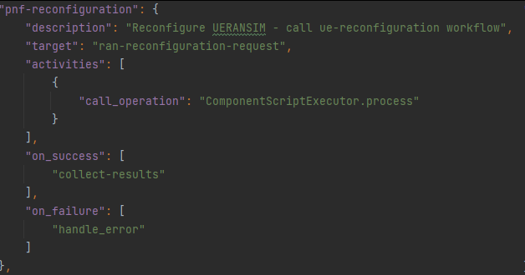
Config Deploy: PNF Reconfiguration
Aim at configuration of PNF base on the configuration resolved from the CNF
Request sent towards UERANSIM component contains parameters required during subscription, eg:
PLMN ID
UE ID
ComponentScriptExecutor operation used
4

Slide 19
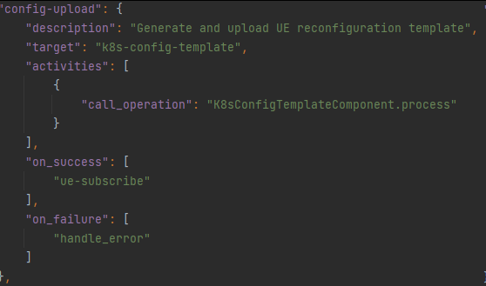
UE Reconfiguration: Config Upload
Configuration template is generated and uploaded to k8sPlugin thanks to utilization of K8sConfigTemplateComponent
Config Template is a Helm package
Part of the original Helm package
Does not have to be related with original Helm package
Create of Updates k8s resourcs
Configuration template contains gnb chart of UERANSIM component with modified values
5

Slide 20
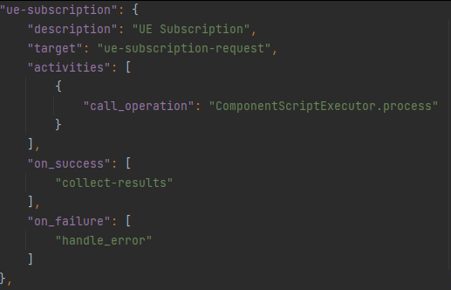
UE Reconfiguration: UE Subscribe
6
Script triggers execution of ue-subscribe workflow
Subscription is required to allow for e2e connectivity from the UE to the internet
ComponentScriptExecutor operation used

Slide 21
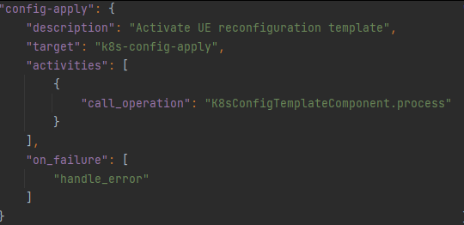
UE Reconfiguration: Config Apply
7
K8sPlugin instantiates the configuration uploaded during config-upload step
As a result:
new gnb pod is created with modified parameters
The old instance is deleted
K8sConfigValuesComponent component is utilized

Slide 22
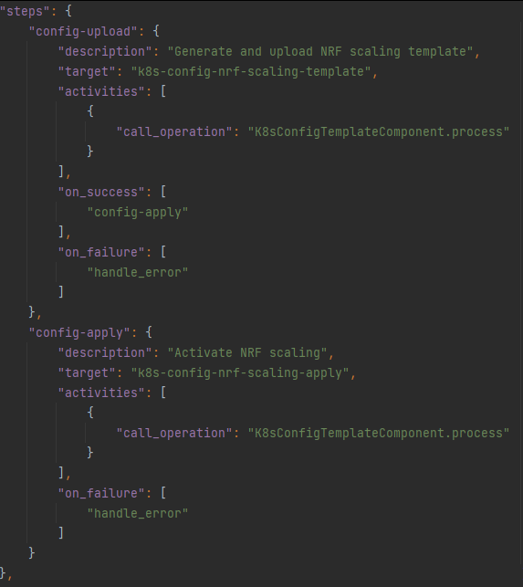
NRF Scaling
8
We combine config-upload and config-apply step that modifies the NRF deployment
K8sConfigTemplateComponent is utilized for config-upload procedure
K8sConfigValuesComponent is utilized for config-apply procedure
Configuration template has NRF deployment template with modified number of NRF replicas
During the configuration apply, new instance of NRF is created

Slide 23
Orchestration of Free5GC with ONAP

Slide 24
VIDEO

Slide 25
Future work & enhancements
RAN Simulator
RAN PNF
UPF
UPF
implemented in P4

Slide 26
Thank you
Merci
धन्यवाद
Dziękujemy

